Slide 1
A Look At DISA STIGs (1)
USA DoD
Security Technical Implementation Guides (STIGs)
Most expansive security benchmarks available
Most regularly updated
Unclassified version
http://iase.disa.mil/stigs/Pages/index.aspx
425 STIGs available

Slide 2
A Look At DISA STIGs (1)
STIGs master list (A-Z):
http://iase.disa.mil/stigs/Pages/a-z.aspx
STIG viewer:
http://iase.disa.mil/stigs/Pages/stig-viewing-guidance.aspx

Slide 3
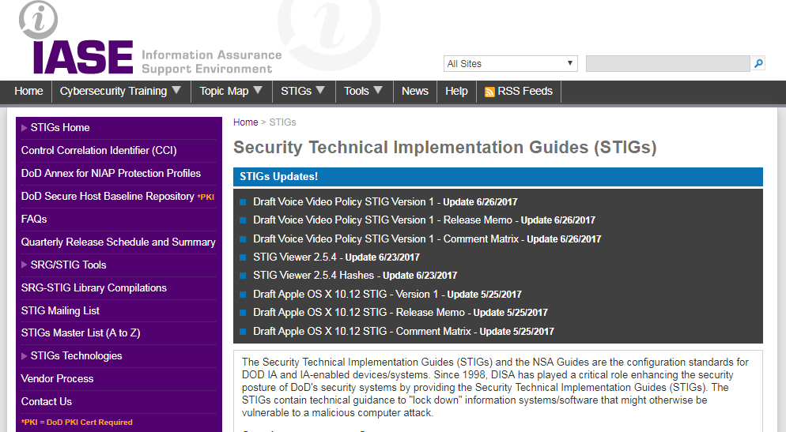
A Look At DISA STIGs (1)
STIGs HOME

Slide 4
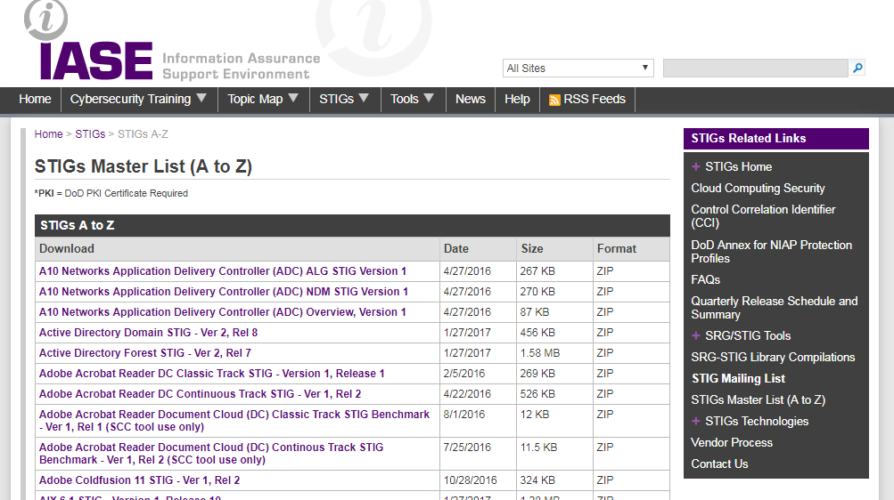
A Look At DISA STIGs (1)
STIGs Master List

Slide 5
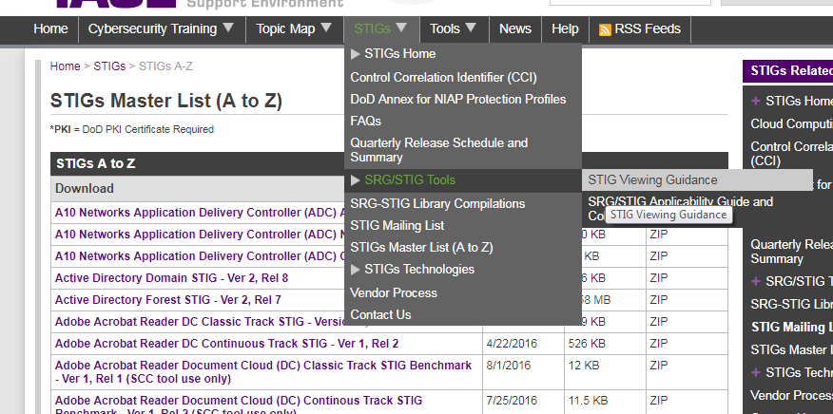
A Look At DISA STIGs (1)
STIGs Viewer

Slide 6
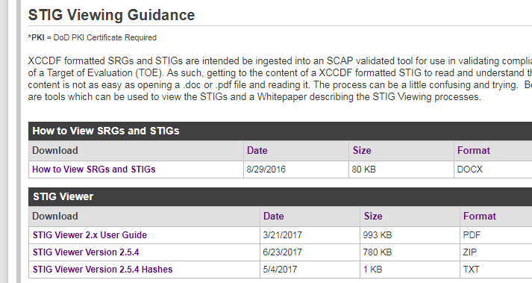
A Look At DISA STIGs (1)
STIG Viewer Download

Slide 7
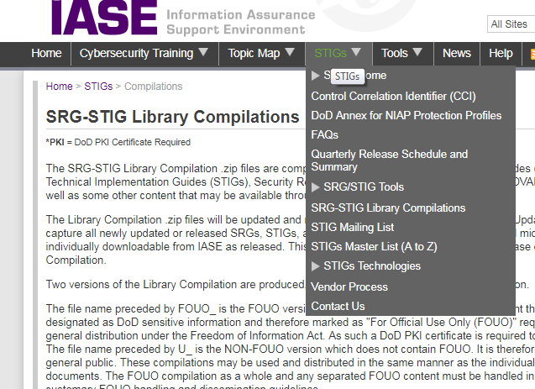
A Look At DISA STIGs (1)
STIG Library Compilation

Slide 8
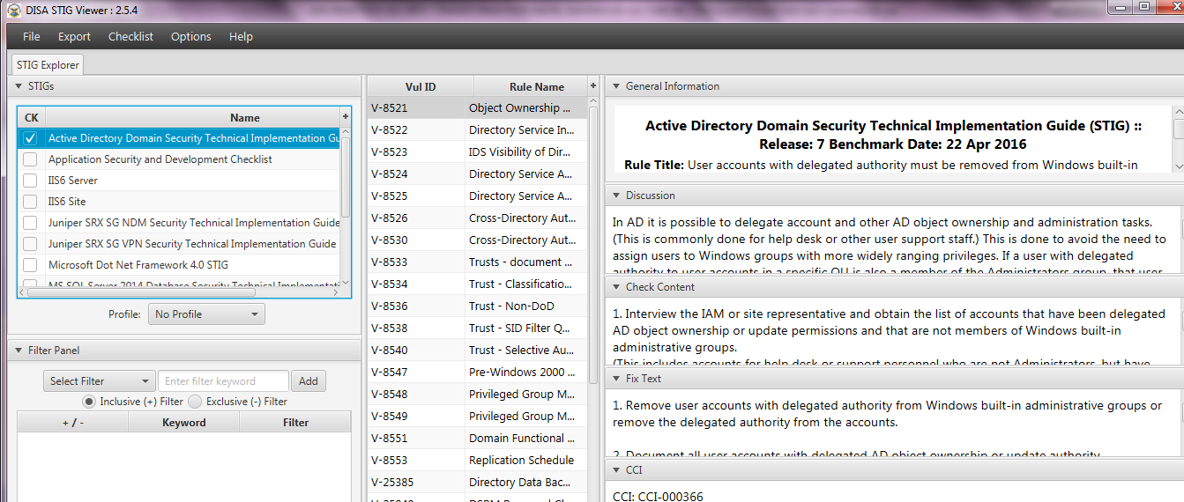
A Look At DISA STIGs (1)
STIG Viewer Window

Slide 9
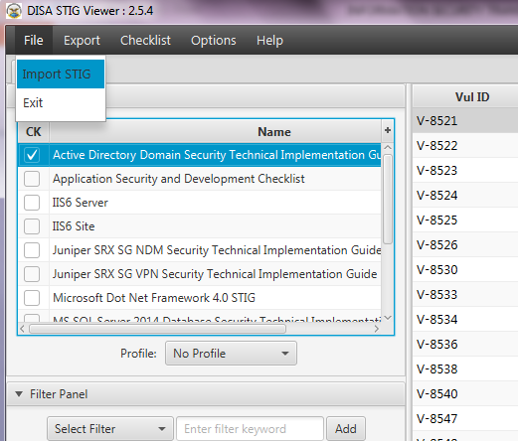
A Look At DISA STIGs (1)
Import STIG

Slide 10
A Look At DISA STIGs (1)
Completely different mechanism for DISA STIGs
END

